Slide 1

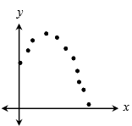
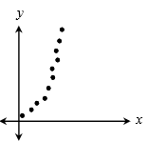
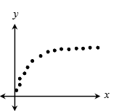
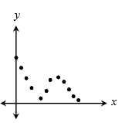
3. The data in the table below gives the engine speed of a boat (in hundreds of revolutions per minute, or RPMs) for several different boat speeds (in knots). Using a cubic equation to best fit the data, determine the boat speed for an engine speed of 2500 RPMs.
Engine Speed (RPMs) | Boat Speed (Knots)
8 | 5.59
10 | 6.88
12 | 7.63
14 | 8.04
16 | 8.29
21 | 9.4
A. 10.72 knots B. 11.16 knots C. 11.87 knots D. 12.23 knots
1. For which set of data would the equation for the curve of best fit most likely be logarithmic?
A.
B.
Use the following functions for questions 4-6:
4. Find .
C.
D.
A. C. B. D.
5. Find .
2. The data below shows the cooling temperatures of a hot cup of tea after it is poured into a cup. Assuming the relationship is exponential, find the approximate temperature after 40 minutes.
A. B. C. D.
Time (Minutes) | Temp (°F)
0 | 184
5 | 166.32
10 | 150.34
15 | 135.9
20 | 122.84
25 | 111.04
A. 82° B. 87° C. 90° D. 95°
6. Find .
A. B. C. D.

Slide 2

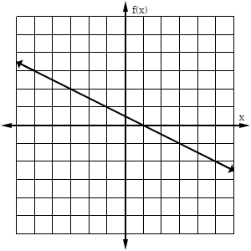
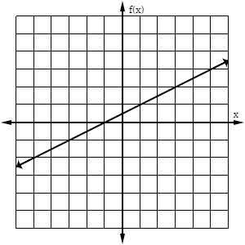
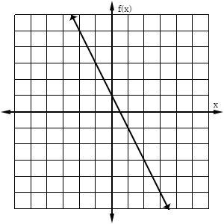
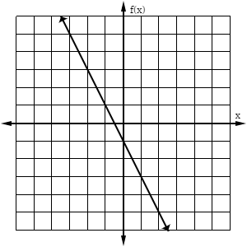
7. If and , find .
11. Which equation represents “z varies inversely with y squared and directly with x?”
A. C. B. D.
A. C. B. D.
If and find .
12. If m varies jointly with n and p, what is the constant of proportionality when m = 32, n = 3, and p = 8?
A. -72 B. 72 C. -48 D. 48
A. C. B. D.
9. Which graph shows the inverse of the function ?
13. If y varies directly as the square root of x and inversely as z cubed, and y = 2.5 when x = 16 and z = 2, find z when x is 64 and y is 0.625.
A.
B.
A. 4 B. 8 C. 16 D. 64
C.
D.
14. The volume of a gas varies directly with its temperature and inversely with its pressure. When the temperature is 125 Kelvin and the pressure is 15 lb/cm², the volume is 100 m³. What is the volume when the temperature is 275 Kelvin and the pressure is 25 lb/cm²?
10. Which function is the inverse of ?
A. 118 m³ B. 125 m³ C. 132 m³ D. 148 m³
A. C. B. D.

